Slide 1
Amazon.com
Requirements:
Search for products.
Recommendations on UserHomepage.
Place Order.
Check Order Status.
Write / View Product Review.
Assumptions:-
User Profile Creation is available.
Product onboard is Provided.
Payment Service is Available.

Slide 2
Non Functional Requiremts:
Low latency(Recommendation & Search)
High Consistency(Placing Order, order Status, and Payments)
Estimation:
Active users:- 300m monthly active users.
Total products: 10m.

Slide 3
Database design:
User db – Sql
user id(primary key)
Username - string
Password- string
Firstname –string
Lastname –string
Email – string
Loginlasttime- datetime
Created account –datetime

Slide 4
2. Address Db- Sql
AddressId- primary Key
User ID –Foreign Key
Effective date: Date
Address: String
Address line1 : String
Address line2: String
City : String
Country: String
Zip: Alphanumeric

Slide 5
3. Product table
If we use sql database for product information, we will be wasting lot of space, so we will be using nosql.(Document Db- Dynamic Db or Mongo Db)
{
“Id”:”124568”,
“Category”:”Cloth”,
“item”:”Tshirt”,
“Gender”:”Female”,
“Size”:”S”
}

Slide 6
4. Review DataBase:
{
“Key”: “23444322134”,
“Rating”:4,
“Description”:”Product review”,
“Images”:[{
“AttachedId”:”73994”
},{
“AttachedId”:”73239”}]
}

Slide 7
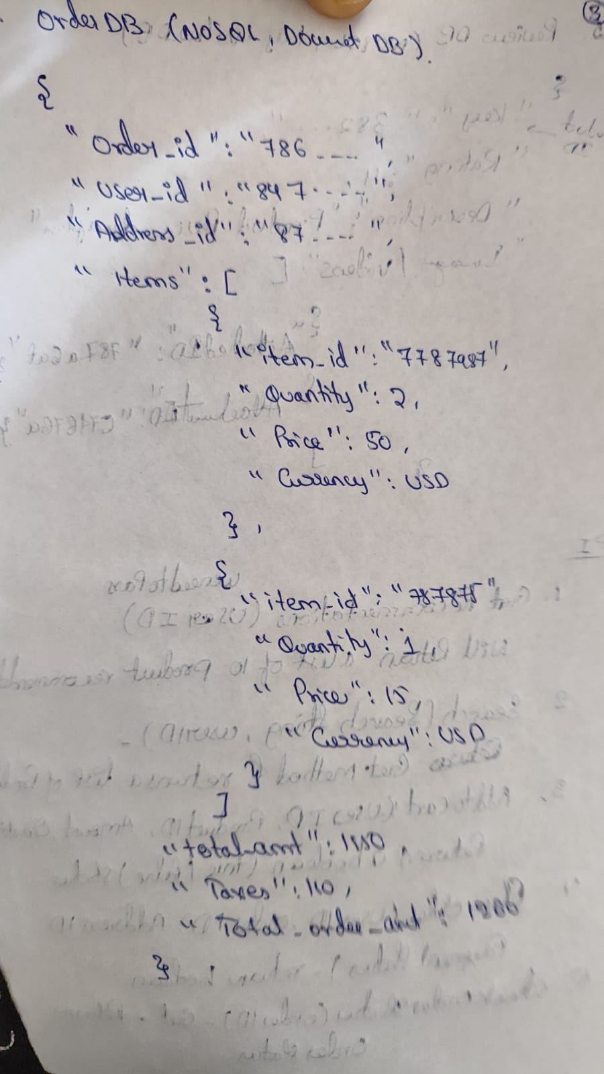
5. Order Db(Nosql)
Example

Slide 8
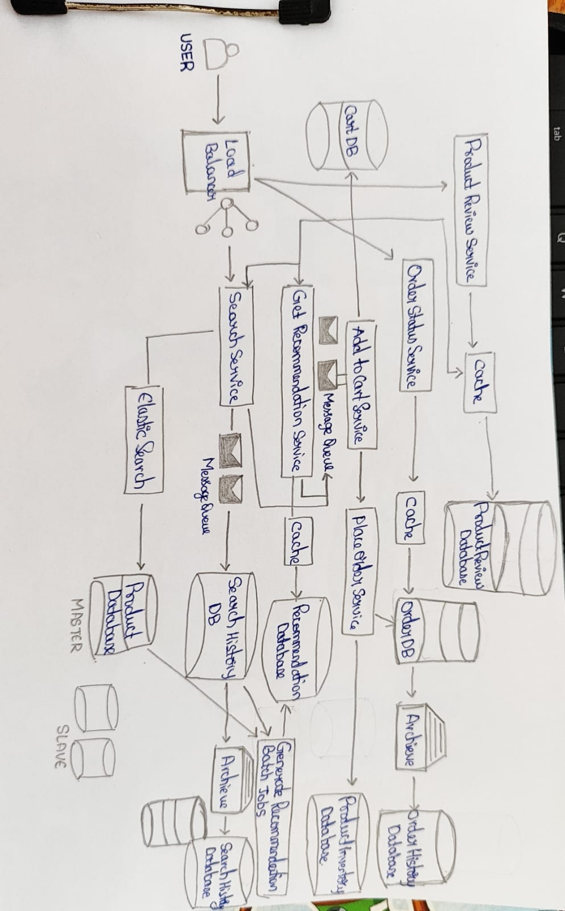
System Design

